Slide 1
CREATING CLEVER
CONVERSATIONS
Association for Fundraising Professionals

Slide 2
T A D
Technology Aversion Disorder

Slide 3
Technology Aversion
Disorder Association
TADA
Mission
TADA is a
501(c)(3) organization established to help ease the suffering of individuals with TAD and those attempting to interact with them.

Slide 4
Goals
Raise awareness of
problem
Raise awareness of
TADA
Develop methodologies
to combat TADA
Develop programs to
implement methodologies
Fundraise to support
organization

Slide 5
Target Audience
People suffering from TAD
Children and other family
members and friends of
people suffering from TAD
Companies or sponsors
that might want to
advertise on TADA website
or other TADA-related
outlets
Media outlets

Slide 6
TAD’s MIDDLE CHILD
Generation X
Notes:
30s and early 40s (1965-1980)
Birth decline after baby boom; significantly smaller than previous and succeeding generations
Rise of two-income families
Independent and self-sufficient (latch-key kids)
From Punk Rock to Hard Rock to Grunge
Responsibility and freedom
Casual disdain for authority and structured work hours
Dislike micro-management/Embrace hands-off
Hard work/hard play
Shift from a manufacturing economy to a service economy
Flexible
Technologically adept
“The great translators”

Slide 7
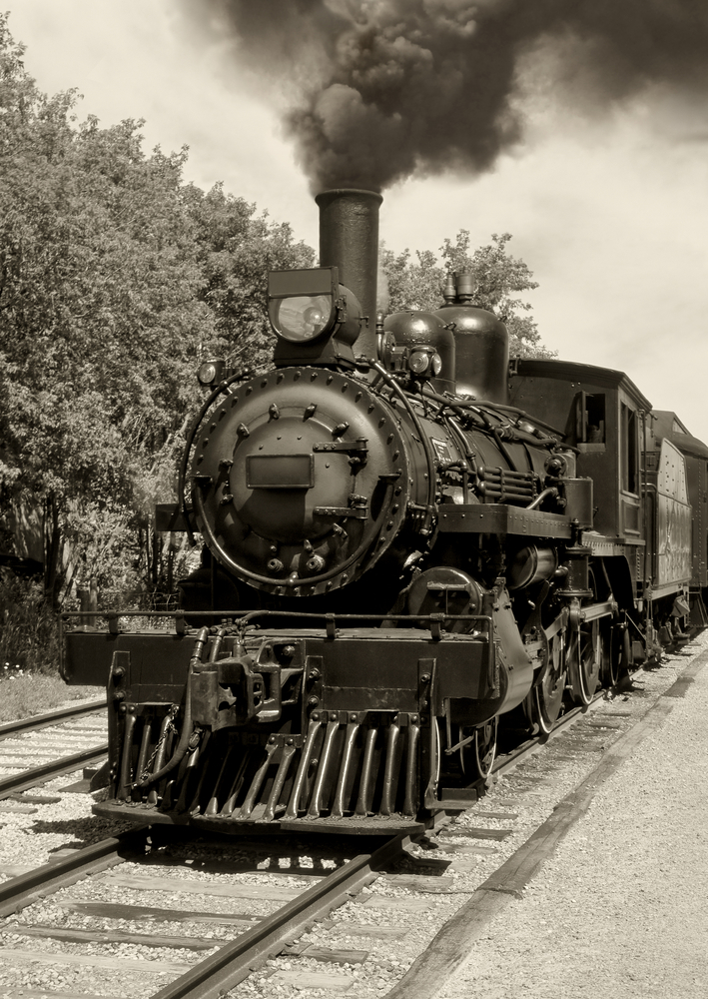
Don’t be a
train wreck!
Marketing Myopia
Notes:
Didn’t stop growing because the need for passenger and freight transportation declined – it GREW.
Saw themselves in the railroad biz, not transportation. Didn’t diversify into cars, trucks, airplanes – even telephones)
Railroads were product-oriented not customer-oriented
Even Hollywood – thought it was in the movie business – not the entertainment business. Movies to TV.

Slide 8

MARKETING MYOPIA
TODAY
“Think Different”
Communication
Content Consumption
Interaction
Where, What, Why, How, When
Notes:
Recent video on You Tube – Baby thinking the magazine was a broken iPad.
Sitting with client @ web design firm.
**Same issue with computers. “In the Age of the Smart Machine.” They are not really cool type writers. Changed the way information moved. Who controlled it. How it was presented. Control – middle mgmt/reengingeer
Doesn’t replace, biz strat, mktg, PR,any concept – brand, logo, social media mktg
Thinking about marketing differently – not just about putting out messages
Driving (texting, talking, watching TV, headsets)
TV (no/few commercials)
Research: Stacks vs. wikipedia, learning about a cause, disease, doctor, organization – if you’re not online – you don’t exist. Online – where your audience looks. Most 15 year olds are not on LI. Most seniors are not on LI.
Reunions: what have you been up to vs. nice comment on FB
Attention span
Dissemination of information/content consumption: books, articles, learning etc. – want entertainment, ability to comment, interact, reach people – not a one-way street
Writing notes in class vs. texting
Staying in touch – Twitter, FB vs. letters
Showing support: “like” a page, RT, Like a post – don’t write checks!
They want e//brand loyalty is different – check-in, get badges, get rewards – they want to be recognized for support – Donate through TEXT MESSAGING

Slide 9
Awareness
Research/Consideration
Purchase/Conversion/SUPPORT
Engage to
earn loyalty
People trust people more than they trust companies.
Know your advocates.
Cultivate and enable them.
Loyalty
Advocacy
Notes:
Read: the new marketing funnel – 2009 (Adam Cohen)
CRM: Old loyalty thinking: Send emails – keep brand top of mind.
Customer’s voice was important, but only in the context of customer service – closed feedback loop.
TAD – what does loyalty and advocacy look like?

Slide 10
Traditional media
and marketing are
not dead!
Social Media Marketing
≠
Internet Marketing
Notes:
Internet Marketing
Promotional tools: direct selling, coupons, ads.
Measurement: SEO, click-throughs, etc.
Easier to understand – like the first computers – use as really advanced/expensive word processors/typewriters and calculators – and a deck of cards.
Social media tools to make internet marketing more effective: Google – can target ads on geography, time of day, day of week, etc. – accurate data.
FB can target specific people – 35 yo Male who went to Columbia for his MBA and likes Zepplin.
Social Media Marketing
Social networking: reaching out, advancing real relationships people, community development – you reach out to places where people are developing relationships – and looking to discover content
Measurement: amplification, influence, etc.
People: SMEs, customers, prospects, and stakeholders, industry experts, influencers, journalists, community activists, politicians
Comm development: discussions, replies, interaction
Key disconnect:
- Promotional tools used in SMM are often jarring and counter-productive.
Also, internet marketing is one-way communication; brand-driven, relatively impersonal
Traditional media is not dead
Websites are not dead
Email marketing is not dead
Not too often, relevant content: informative
They need to be reinvigorated and made relevant
Social media is not everything
RELATE BACK TO TAD

Slide 11
Digital media is a demanding relationship
Facebook asks what I’m thinking.
Twitter asks what I’m doing. Foursquare asks where I am.
The internet has turned into
a crazy girlfriend.
Tracy Morgan
“People need to realize Facebook
is a social networking site,
not a diary.”
  “Twitter has
  replaced muttering
  to yourself on the couch”

Slide 12
Don’t Waste time and
Resources
  Reinvigorate all channels
  Align all campaigns
  Consistency: Brand, messaging, story
  Resources available
  to implement
  “The Audience is Listening.” Are you?
  Understand “engagement”
X
Me, too!
  GOALS
  STRATEGY
  TOOLS
  ACTION PLAN
  REVIEW AND EVALUATION PLAN
Notes:
Don’t try the “me, too” strategy.
Consistency in brand, voice, presence
Responsive – “that’s so 5 minutes ago.”
“Nice” –
FB: social portal – log in instead of IM or talking to 100s of people they know. Don’t have to send out photo albums.
Twitter: instantaneous, podium
Diff comm styles for diff outlets – like bar vs. work vs. wedding vs. courtroom
Goals: engage, ask questions, get amplified, get top of mind, be seen as value
The tools are all friends – but we’re not playing telephone.
Evaluation not just about meeting goals – about reaction from audience
Customer engagement is not the same as conversations
- Don’t just say, act!
Focus on more than just transactions and specific interactions – need to manage the entire relationship
The act of working wf a consumer and an org or brand interactivng witin the consumer’s network of relevance. - measure by takeaway value, snetiment and resulting actions following interaction not just communication/experiences that mean something, positive, worth sharing
REINVIGORATE ALL CHANNELS Tools
All social media is NOT the same
Bi-directional
Social, mobile, web, “local”

Slide 13
  SOCIAL MEDIA MARKETING
  CONTENT IS KING.
  THE TOOLS ARE ALL FRIENDS.
Develop a content strategy
Provide value; be a resource
Educate, connect, entertain
What is your role?
media, publisher,
content curator, authority
Establish methods to gather
and identify content
Notes:
Bobby- ACG – let’s not do anything- but let’s promote this event, now!
Content results take time
Boosts search engine results
Compliments marketing, sales
Plan time and methods to gather content
What kind of content
Engaging
Campaigning (taking action)
Tools
All social media is NOT the same
Bi-directional
Social, mobile, web, “local”
Of value and interest
“Content curator”
Person, with a personality
Use content from donors, promote sponsors, supporters

Slide 14
Building TADA’s Campaign:
The
Rhetorical Triangle
  Goals
  Strategy
  Tools
  Action Plan
  Review & Evaluation Plan
Purpose
Audience
Voice
Subject
Notes:
Only thing missing is the HOW/WHERE
TADA
Unlike one person giving the final approval, social media allows everyone to take part in promoting something.
Just learn more about your consumers focus on people, enable great storytelling, create great experiences Personal, brand experience and story
Engage
Invest time and money to moderate the community
Business from family
Brands as personal
Model – law firm
Diff depts. –
Imagine a law firm with 50 people 5 depts
What did they do?
Sponsor conf
Colors name
In addition
Individuals at firms, in different depts.
Experts in that area
Talking as the expert – with that person’s name
Bring them to the law firm
Technology aversion disorder
Primarily affects baby boomers (some gen Xers and millenials)
Whose affected by it
Vs. who is donating to fix it
Where are they why this appeals to them
What appeals to them, what else are they interested in
How do we keep them interested
Hypothetical disorder
Trend – campaign
TADA – technology aversion disorder awareness
3 major audiences
Creating awareness
Funding
PR issues as they arise
Diff aud/generational
Why need to understand traditional and new marketing/media
Marketing/PR
Overarching plan, traditional advertisement
- This is in fact a disorder, don’t underestimate impact – communicate to that audience through traditional media – have it – aren’t using technology – thru traditional avenues (tv commercials, broadcast – b/c not using DVR/TiVO)
- Funding, any PR issues that arise
we know most likely – (surveys) millennial – reason is they have had it with inability to comm. with parents, grandparents, bosses/colleagues at work
in addition get to them through social media
support groups – millenials dealing with people afflicted,
Organization, FB – LI – Twitter hastags
Likely

Slide 15

Building a base community
Each community
will be different.
How do you
find yours?
Directly Related
Tangentially Related
Where are they?
Credit: Idea go/www.freedigitalphotos.net
Credit: Idea go/www.freedigitalphotos.net

Slide 16
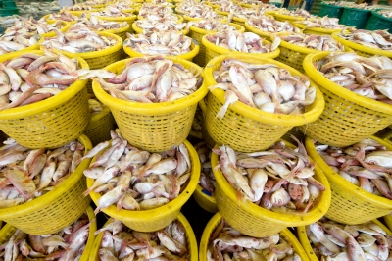
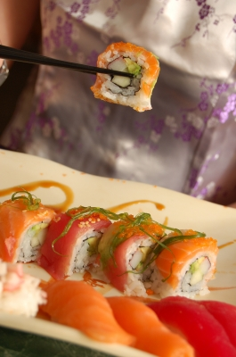
Quality over quantity
OR
Credit: think4photop/www.freedigitalphotos.net
Credit: Daniel St.Pierre/www.freedigitalphotos.net
1000 active followers with
10,000 followers of their own
>
100,000 followers who never sign on

Slide 17

Don’t feel overwhelmed!
Doesn’t have to be your
magnum opus,
a paragraph or two will do.
Publicize it!
You wouldn’t write an e-blast
without blasting it, would you?
Credit: Ambro/www.freedigitalphotos.net

Slide 18

When and how often?
BLOGGING
TWITTER
  7-8am and 12pm EST
  3 posts per week
  More is always better
  12pm and 5-6pm EST
  Wednesday and Friday
  1-4 posts per hour
FACEBOOK
LINKEDIN
  7-8am, 12pm and 5-6 EST
  Saturday
  1-2 posts per day
Copyright © Cleversation LLC 2011.
All rights reserved.
Credit: photostock/www.freedigitalphotos.net

Slide 19
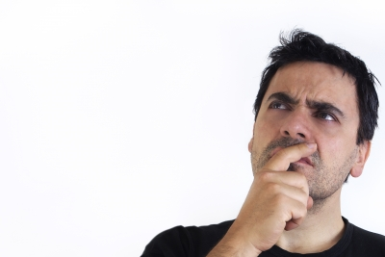
How to get retweeted?
Powerful Quote
Lists/Guides
Links
Ask Politely for
a Retweet
51% of tweets that included 'Please Retweet' were retweeted more than once (HubSpot)
Credit: Danilo Rizzuti/ www.freedigitalphotos.net

Slide 20
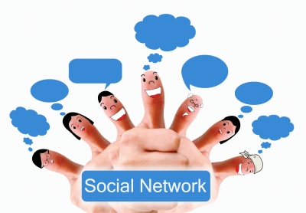
Start a group!
…for family and friends of those afflicted with TAD
Facebook Group
LinkedIn Group
Control the Conversation
Credit: Kookkai_nak/ www.freedigitalphotos.net

Slide 21
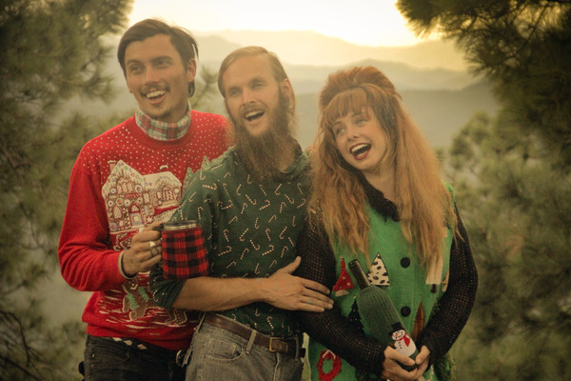
Crowdfunding
Kickstarter
  Freaker USA raised the money they needed to take their business to the next level using social media and video.
  Why can’t TADA do that?
  Why can’t you?
Credit: www.freakerusa.com

Slide 22

Social video
Adding video improves SEO
YouTube
Owned by Google
Shows up first on
Google searches
Credit: Renjith Krishnan/ www.freedigitalphotos.net
Optimize Videos
  8 seconds
  Tag videos
  Embed in blog
  Share
Copyright © Cleversation LLC 2011.
All rights reserved.

Slide 23

Monitoring and measuring
Our goals were to spread awareness and offer support.
What are your goals?
  Increase donations?
  Increase SEO?
  Foster goodwill?
  Something else entirely?
Credit: vichie81/www.freedigitalphotos.net

Slide 24
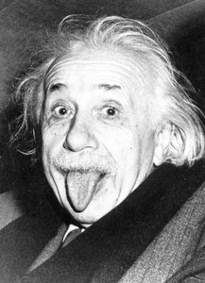
If it’s not working, change it up!
The definition of insanity is doing the same thing over and over and expecting a different result.
Marketing and social media are ever-evolving, and so must you be.

